Slide 1


Movies Data Analysis Project
A student project analyzing movie data using Python tools and models.
by Ahmed Hassan

Slide 2
Course and Student Details
Department & Course
Student Info
Mathematics and Computer Science
Name: Ahmed Hassan Ali
Selected Topics in Statistics (Stat 415)
ID: 20231467850
Professor: Dr. Asmaa ELKady
Level: Four
Due Date: May 12th

Slide 3

Advanced Movie Data Analysis using Python
🔗 Project Repository
The full source code, data, and dashboard can be found on GitHub:
📎GitHub Repository:https://github.com/Elabiad-777/Book-Data-Analysis-.git

Slide 4



Introduction
Project Goal
Analyze movie data to explore and model key attributes.
Workflow
Data cleaning, EDA, feature engineering, modeling, and communication.

Slide 5
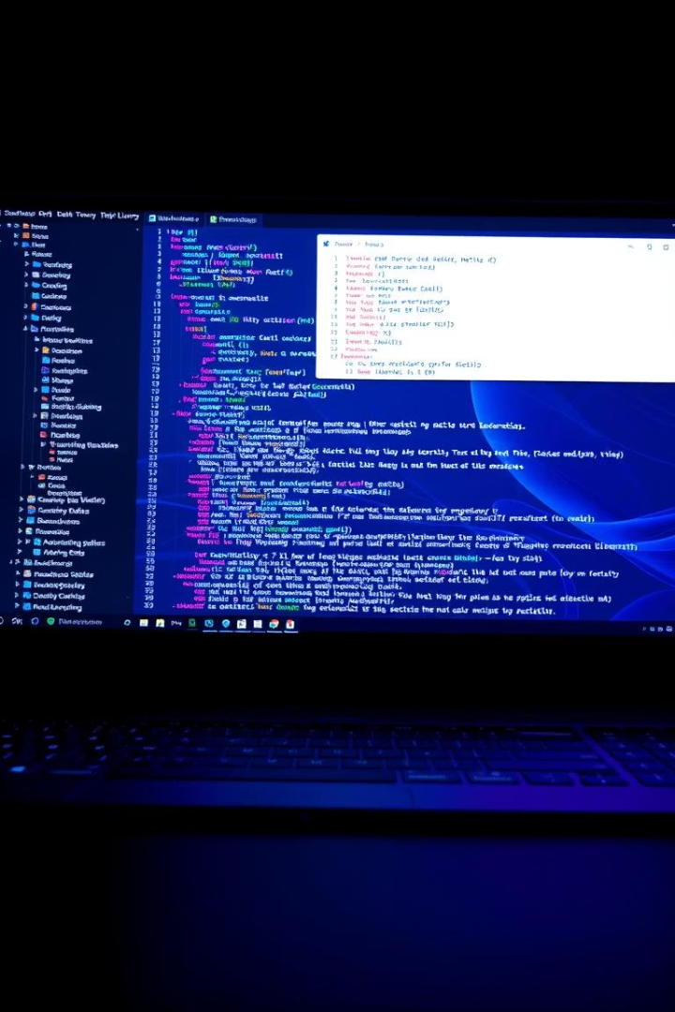
Tools & Technologies
1
Programming Language
Python
2
Libraries
pandas
numpy
matplotlib
seaborn
plotly
scikit-learn
streamlit
3
IDE & Dataset
Jupyter Notebook & Streamlit
Movies Data (CSV format)

Slide 6



Data Cleaning
Steps Taken
Additional Actions
Handled missing values and converted datatypes.
Removed duplicates, created revenue categories, filtered genres and runtimes.

Slide 7
Exploratory Data Analysis (EDA)
Key Insights
Visualizations
Ratings mostly between 6 and 8
Histograms, Boxplots, Heatmaps
Runtime varies by genre and revenue
Scatter plots with trendlines
Higher budgets link to higher revenue
Interactive Plotly charts on Streamlit
Positive budget-revenue correlation

Slide 8



Feature Engineering
New Features
Created revenue categories using quantiles.
Other Transformations
Parsed genres and converted dates to release years.

Slide 9
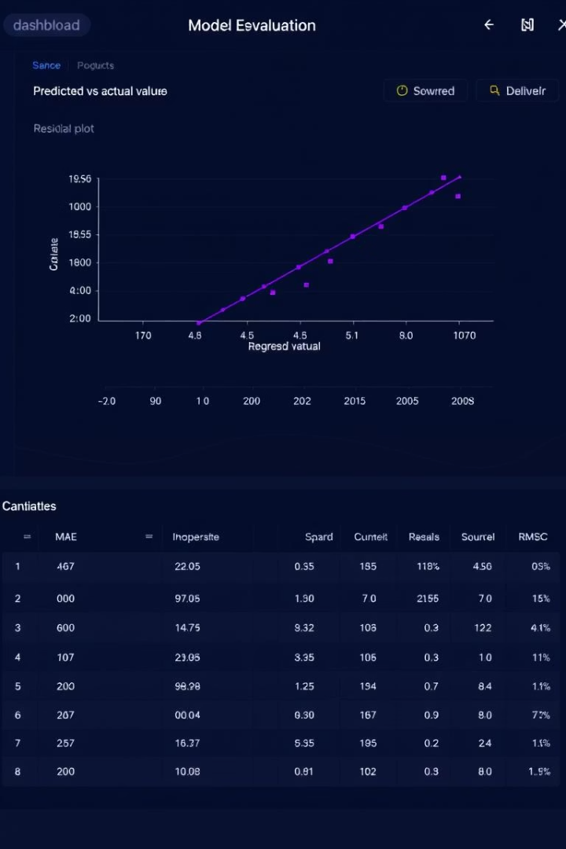
Modeling & Evaluation
Model
MSE
R² Score
Linear Regression
2.1e+09
0.72
Ridge Regression
2.1e+09
0.72
Lasso Regression
2.3e+09
0.69
Decision Tree
1.8e+09
0.75

Slide 10
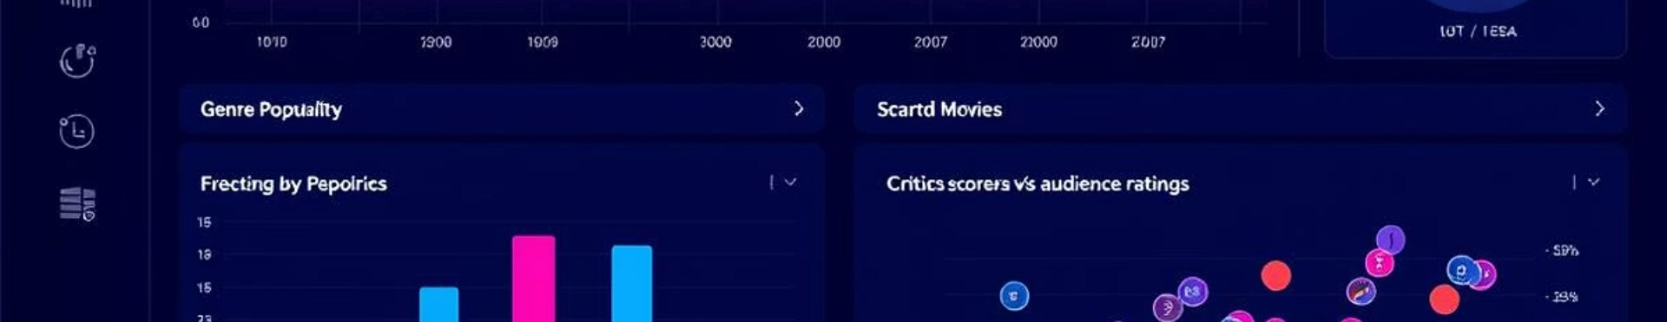
Streamlit Dashboard Demo
Tabs Included
Overview: Summary stats and charts
Relationships: Scatter plots and heatmaps
ML Insights: Predictions and model comparisons
Raw Data: Filtered dataset and CSV download

